Slide 1
Advanced Algorithms
Weiwei Wu

Slide 2
Outline
Stable concept
  Equilibrium
  Truthfulness: strong equilibrium
  This week Stable concept
  Stable matching
    How to pair the boys/girls
    Research example: stable matching with tie (open for you)
  Equilibrium concepts
    Example: voting game, mean value game, auction game
    Research example: VM auction design (open for you)

Slide 3
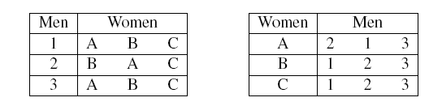
Stability
Problem: stable matching
  N mens
  N womens
  Preference list of others
  Any good algorithm for good pairing?
  E.g.

Slide 4
Stable
Problem: stable matching
  N men
  N women
  Preference list of others
  Any good algorithm for good pairing?
  E.g.
  How to measure “good”?
    Number of first ranked choices maximized?
    Number of last ranked choices minimized？
    Sum of the ranks of the choices minimized?

Slide 5
Stable
Problem: stable matching
  N mens
  N womens
  Preference list of others
  Any good algorithm for good pairing?
  E.g.
  How to measure “good”?
    Number of first ranked choices maximized?
    Number of last ranked choices minimized？
    Sum of the ranks of the choices minimized?
    Stable? What should it be?

Slide 6
Stable
Problem: stable matching
  N mens
  N womens
  Preference list of others
  Any good algorithm for good pairing?
  E.g.
  How to measure “good”?
    Number of first ranked choices maximized?
    Number of last ranked choices minimized？
    Sum of the ranks of the choices minimized?
    All perfect, e.g. rank 1, is almost impossible
    Stable? What should it be? Reversely, unstable?

Slide 7
Stable
Problem: stable matching
  Stable:
    Every pair is content with the state←→no existence of unstable couple
    What is unstable in the example?

Slide 8
Stable
Problem: stable matching
  Stable:
    Every pair is content with the state←→no existence of unstable couple
    Which edge is unstable in the example?

Slide 9
Stable
Problem: stable matching
  Stable:
    Every pair is content with the state←→no existence of rogue couple
    What is unstable in the example?

Slide 10
Stable
Problem: stable matching
  Stable:
    Every pair is content with the state←→no existence of rogue couple
    What is unstable in the example?
elope

Slide 11
Stable
Problem: stable matching
  Stable:
    Every pair is content with the state←→no existence of rogue couple
    What is stable in the example?

Slide 12
Stable
Problem: stable matching
  Stable:
    Every pair is content with the state←→no existence of rogue couple
    What is stable in the example?
    Q: whether a stable matching always exists?
    Q: how to find the stable matching
      What is your method?

Slide 13
Stable
Problem: stable matching
  Stable:
    Every pair is content with the state←→no existence of rogue couple
    What is stable in the example?
    Q: whether a stable matching always exists?
    Q: how to find the stable matching
      What is your method? Step by step?

Slide 14
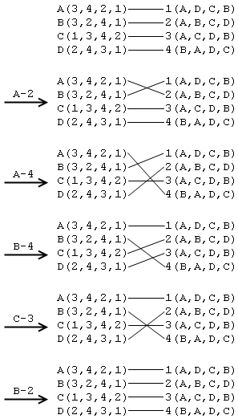
Stable
Problem: stable matching
  Stable:
    Q: how to find the stable matching
      What is your method? Step by step?
    A: dead loop?
    Q: what is the algorithm?
    A: 1962, Gale and Shapley
      2012, Nobel

Slide 15
Stable
Problem: stable matching
  The algorithm:
    Q: think in your way, in real life.
      Girls: ?
      Boys: ?

Slide 16
Stable
Problem: stable matching
  The algorithm:
    Q: think in your way, in real life.
      Girls: passive but choosy
      Boys: active

Slide 17
Stable
Problem: stable matching
  The algorithm:
    Q: think in your way, in real life.
      Girls: passive but choosy
      Boys: active
      Boys: post Girls: accept?delay?how to gain better?

Slide 18
Stable
Problem: stable matching
  The algorithm:
    Q: think in your way, in real life.
      Girls: passive but choosy
      Boys: active
      Boys: post Girls: accept?delay?how to gain better?
      Boys: post Girls: say maybe and reject impossible

Slide 19
Stable
Problem: stable matching
  The algorithm:
    Q: think in your way, in real life.
      Girls: passive but choosy
      Boys: active
      Boys: post Girls: accept?delay?how to gain better?
      Boys: post Girls: say maybe and reject impossible
      What if rejected?

Slide 20
Stable
Problem: stable matching
  The algorithm:
    Q: think in your way, in real life.
      Girls: passive but choosy
      Boys: active
      Boys: post Girls: accept?delay?how to gain better?
      Boys: post Girls: say maybe and reject impossible
      What if rejected?
        Next round
    ALG: ?

Slide 21
Stable
Problem: stable matching
  The algorithm:
    Q: think in your way, in real life.
      Girls: passive but choosy
      Boys: active
      Boys: post Girls: accept?delay?how to gain better?
      Boys: post Girls: say maybe and reject impossible
      What if rejected?
        Next round
    ALG: ?
      Each round
        (non-candidate) Men post (according to list)
        Women say maybe (let the men be candidate) and reject impossible ones
        Women advantage: say maybe if better and reject previous one

Slide 22
Stable
ALG
      Each round
        (non-candidate) Men post (according to list)
        Women say maybe (let the men be candidate) and reject impossible ones
        Women advantage: say maybe if better and reject previous
      When terminate?
        Every one non-single
  What should we show to prove the optimality?

Slide 23
Stable
ALG
      Each round
        (non-candidate) Men post (according to list)
        Women say maybe (let the men be candidate) and reject impossible ones
        Women advantage: say maybe if better and reject previous
      When terminate?
        Every one non-single
    Why terminate?

Slide 24
Stable
ALG
      Each round
        (non-candidate) Men post (according to list)
        Women say maybe (let the men be candidate) and reject impossible ones
        Women advantage: say maybe if better and reject previous
      When terminate?
        Every one non-single
    Why terminate?
      Men post all list→Women on the list and posted
      Once posted, it will not be single at the end
      →all women non-single
      Two women tie one men? Post in sequence and repost after reject →one-to-one→all matching

Slide 25
Stable
ALG
      Each round
        (non-candidate) Men post (according to list)
        Women say maybe (let the men be candidate) and reject impossible ones
        Women advantage: say maybe if better and reject previous
      When terminate?
        Every one non-single
    Terminate in how much time?
      List post times

Slide 26
Stable
ALG
      Each round
        (non-candidate) Men post (according to list)
        Women say maybe (let the men be candidate) and reject impossible ones
        Women advantage: say maybe if better and reject previous
      When terminate?
        Every one non-single
    Compute e.g.

Slide 27
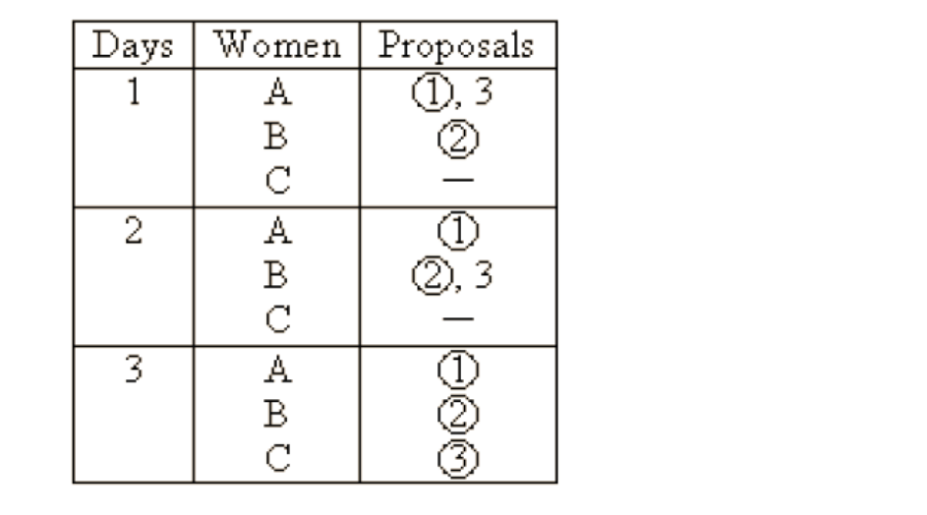
Stable
ALG
      Each round
        (non-candidate) Men post (according to list)
        Women say maybe (let the men be candidate) and reject impossible ones
        Women advantage: say maybe if better and reject previous
      When terminate?
        Every one non-single
    Compute e.g.

Slide 28
Stable
ALG
      Each round
        (non-candidate) Men post (according to list)
        Women say maybe (let the men be candidate) and reject impossible ones
        Women advantage: say maybe if better and reject previous
      When terminate?
        Every one non-single
Why stable?
      What improve?

Slide 29
Stable
ALG
      Each round
        (non-candidate) Men post (according to list)
        Women say maybe (let the men be candidate) and reject impossible ones
        Women advantage: say maybe if better and reject previous
      When terminate?
        Every one non-single
Why stable?
      What improve?
        Woman improves when rejects, why? In formal, say women w tie m after day k, say day j>k that she degrade to m’, then m>m’ and contradicts with ‘Women advantage’
      A Men m: (proof from men side)
        Not posted edges →okay
        Rejected edged →say w*→rejected→ women improve and like others m*>m
      Q leave for u: prove from women side

Slide 30
Stable
Problem: stable matching
    Elegant result
    Done?

Slide 31
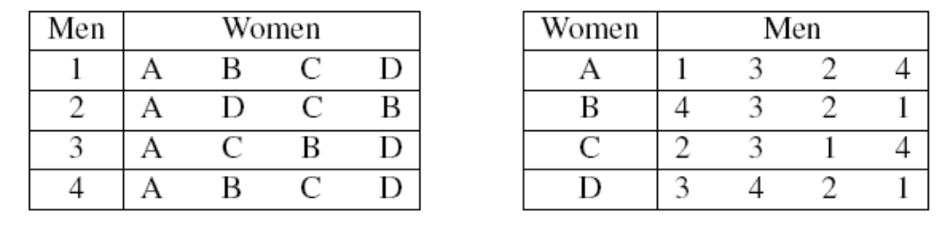
Stable
Problem: stable matching
    More about the stabilities:
      Is your strategy good?
      Uniqueness?

Slide 32
Stable
Problem: stable matching
    More about the stabilities:
      Is your strategy good?
      Uniqueness?
      Q: Find all stable matchings
      Any thing more?
        Consider what if women post?
        What differs? Which is better?

Slide 33
Stable
Problem: stable matching
    More about the stabilities:
      Is your strategy good?
      Uniqueness?
      Q: Find all stable matchings?how to find more?

Slide 34
Stable
Problem: stable matching
    More about the stabilities:
      Is your strategy good?
      Uniqueness?
      Find all stable matchings
      Any thing more?
        Consider what if women post?
        What differs? Which is better?
      What do you learn from this?

Slide 35
Stable
Problem: stable matching
    More about the stabilities:
      Is your strategy good?
      Uniqueness?
      Find all stable matchings
      Any thing more?
        Consider what if women post?
        What differs? Which is better?
        Q leave for u: why?
What do you learn from this?
    Make the first move!

Slide 36
Stable
Problem: stable matching
    Done?

Slide 37
Stable
Problem: stable matching
    Done?
    What possible weakness to be considered?

Slide 38
Mobile System, mechanism design and competitiveness
Thank U!
http://cse.seu.edu.cn/people/weiweiwu
weiweiwu@seu.edu.cn
Notes:
Combinatorial Optimization in Action
Flying a plane, riding a bus, buying a writing pad, or making a
phone call: Can you imagine that combinatorial optimization has
something to do with these activities? This lecture will provide
answers and show how the techniques of discrete mathematics
influence our daily life.
Combinatorial optimization in action
Combinatorial optimization exploded on the mathematical and scientific scene in the 1950s. In this lecture I will briefly survey its development for a wide audience. Theoretical design and analysis of algorithms dominated the early development of the field, while computational progress has been particularly significant in the last twenty years. These theoretical and computational achievements, combined with successful modeling of applications, have made it possible today to solve real-world problems of breathtaking size and diversity. The majority of the lecture will report on success stories in areas such as telecommunication, transportation, traffic and logistics. These results are based on ongoing cooperation between industry, the DFG Research Center MATHEON and my research group at Konrad-Zuse-Zentrum (ZIB).

Slide 39
Equilibrium
Concept of equilibrium
    Selfish
    State to change: stable
    Concept of dominated strategy
      u_i(s_i’,*)<=u_i(s_i,*), then s_i’ dominated by s_i

Slide 40
Equilibrium
Concept of equilibrium
    Selfish
    State to change: stable
    Concept of dominated strategy
      u_i(s_i’,*)<=u_i(s_i,*), then s_i’ dominated by s_i
Problem: voting game
    10 seats
    2 candidates
    Choose position and gain the people nearest to him
    How to choose position
  Q: any dominated strategy?

Slide 41
Equilibrium
Concept of equilibrium
    Selfish
    State to change: stable
    Concept of dominated strategy
      u_i(s_i’,*)<=u_i(s_i,*), then s_i’ dominated by s_i
Problem: voting game
    10 seats
    2 candidates
    Choose position and gain the people nearest to him
    How to choose position
  Q: any dominated strategy?
    What about u(1,*) vs u(2,*)

Slide 42
Equilibrium
Concept of equilibrium
    Selfish
    State to change: stable
    Concept of dominated strategy
      u_i(s_i’,*)<=u_i(s_i,*), then s_i’ dominated by s_i
Problem: voting game
    10 seats
    2 candidates
    Choose position and gain the people nearest to him
    How to choose position
  Q: any dominated strategy?
    What about u(1,*) vs u(2,*)
  Q: what is the result of choosing

Slide 43
Equilibrium
Concept of equilibrium
    Selfish
    State to change: stable
    Concept of dominated strategy
      u_i(s_i’,*)<=u_i(s_i,*), then s_i’ dominated by s_i
Problem: voting game
    10 seats
    2 candidates
    Choose position and gain the people nearest to him
    How to choose position
  Q: any dominated strategy?
    What about u(1,*) vs u(2,*)
  Q: what is the result of choosing
    U(5,?)
  What do you think about the state?

Slide 44
Equilibrium
Concept of equilibrium
    Selfish
    State to change: stable
    Concept of dominated strategy
      u_i(s_i’,*)<=u_i(s_i,*), then s_i’ dominated by s_i
Problem: voting game
    10 seats
    2 candidates
    Choose position and gain the people nearest to him
    How to choose position
  Q: any dominated strategy?
    What about u(1,*) vs u(2,*)
  Q: what is the result of choosing
    U(5,5)
  What do you think about the state?
  What will you define ‘equilibrium’?
  What applications have u been inspired?

Slide 45
Equilibrium
Concept of equilibrium
    Selfish
    State to change: stable
    Concept of dominated strategy
      u_i(s_i’,*)<=u_i(s_i,*), then s_i’ dominated by s_i
Problem: voting game
  What will you define ‘equilibrium’?
    A state S=(s_i,s_{-i}) that u_i(s_i’,*)<=u_i(s_i,*) for any s_i’, any I
    What is the equilibrium in the game

Slide 46
Equilibrium
Concept of equilibrium
    A state S=(s_i,s_{-i}) that u_i(s_i’,*)<=u_i(s_i,*) for any s_i’, any i，and any s_{-i}
    Comparison

Slide 47
Equilibrium
Concept of equilibrium
    A state S=(s_i,s_{-i}) that u_i(s_i’,*)<=u_i(s_i,*) for any s_i’, any i，and any s_{-i}
To deal with cheatings:
    S=true bids

Slide 48
Equilibrium
Concept of equilibrium
    A state S=(s_i,s_{-i}) that u_i(s_i’,*)<=u_i(s_i,*) for any s_i’, any i，and any s_{-i}
To deal with cheatings:
    S=true bids
Problem: Virkery auction
  1 good
  N bidders with valuation v_i
  Sealed bid
  Payment p_i
  Utility u_i=v_i-p_i if win
  Q: How to stimulate the bidders bid his true value v_i
Truthfulness

Slide 49
Equilibrium
Concept of equilibrium
    A state S=(s_i,s_{-i}) that u_i(s_i’,*)<=u_i(s_i,*) for any s_i’, any i，and any s_{-i}
To deal with cheatings:
    S=true bids
Problem: Virkery auction
  1 good
  N bidders with valuation v_i
  Sealed bid
  Payment p_i
  Utility u_i=v_i-p_i if win
  Q: How to stimulate the bidders bid his true value v_i
Truthfulness
Possible? How?

Slide 50
Equilibrium
Concept of equilibrium
    A state S=(s_i,s_{-i}) that u_i(s_i’,*)<=u_i(s_i,*) for any s_i’, any i，and any s_{-i}
To deal with cheatings:
    S=true bids
Problem: Virkery auction
  1 good
  N bidders with valuation v_i
  Sealed bid
  Payment p_i
  Utility u_i=v_i-p_i if win
  Q: How to stimulate the bidders bid his true value v_i
Truthfulness
Possible? How?
  First win, second price
Why truthful?

Slide 51
Equilibrium
Concept of equilibrium
    A state S=(s_i,s_{-i}) that u_i(s_i’,*)<=u_i(s_i,*) for any s_i’, any i，and any s_{-i}
To deal with cheatings:
    S=true bids
Problem: Virkery auction
  1 good
  N bidders with valuation v_i
  Sealed bid
  Payment p_i
  Utility u_i=v_i-p_i if win
  Q: How to stimulate the bidders bid his true value v_i
Truthfulness
Possible? How?
  First win, second price
Why truthful?
  Q: Show the proof?
    Man with largest value:
    Q: others?
Think about English Auction (increase till no one accepts)

Slide 52
Equilibrium
Concept of equilibrium
    A state S=(s_i,s_{-i}) that u_i(s_i’,*)<=u_i(s_i,*) for any s_i’, any i，and any s_{-i}
To deal with cheatings:
    S=true bids
Problem: Virkery auction
  1 good
  N bidders with valuation v_i
  Sealed bid
  Payment p_i
  Utility u_i=v_i-p_i if win
  Q: How to stimulate the bidders bid his true value v_i
Truthfulness
Possible? How?
  First win, second price
Why truthful?
  Q: Show the proof?
Think about about English Auction (increase till no one accepts)
Applications: vm auction, ad auction
Problems: multi-good, multi-dimentional, revenue

Slide 53
Equilibrium
Concept of equilibrium
    A state S=(s_i,s_{-i}) that u_i(s_i’,*)<=u_i(s_i,*) for any s_i’, any i，and any s_{-i}
To deal with cheatings:
    S=true bids
Problem: Virkrey auction
  1 good
  N bidders with valuation v_i
  Sealed bid
  Payment p_i
  Utility u_i=v_i-p_i if win
  Q: How to stimulate the bidders bid his true value v_i
Truthfulness
Possible? How?
  First win, second price
Why truthful?
  Q: Show the proof?
Think about about English Auction (increase till no one accepts)
Applications: vm auction, ad auction
Problems: multi-good, multi-dimentional, revenue

Slide 54
Mobile System, mechanism design and competitiveness
http://cse.seu.edu.cn/people/weiweiwu
weiweiwu@seu.edu.cn
Notes:
Combinatorial Optimization in Action
Flying a plane, riding a bus, buying a writing pad, or making a
phone call: Can you imagine that combinatorial optimization has
something to do with these activities? This lecture will provide
answers and show how the techniques of discrete mathematics
influence our daily life.
Combinatorial optimization in action
Combinatorial optimization exploded on the mathematical and scientific scene in the 1950s. In this lecture I will briefly survey its development for a wide audience. Theoretical design and analysis of algorithms dominated the early development of the field, while computational progress has been particularly significant in the last twenty years. These theoretical and computational achievements, combined with successful modeling of applications, have made it possible today to solve real-world problems of breathtaking size and diversity. The majority of the lecture will report on success stories in areas such as telecommunication, transportation, traffic and logistics. These results are based on ongoing cooperation between industry, the DFG Research Center MATHEON and my research group at Konrad-Zuse-Zentrum (ZIB).

Slide 55
Equilibrium
Concept of equilibrium
    Selfish
    State to change: stable
    Concept of dominated strategy
      u_i(s_i’,*)<=u_i(s_i,*), then s_i’ dominated by s_i
Problem: voting game
  What will you define ‘equilibrium’?
    A state S=(s_i,s_{-i}) that u_i(s_i’,*)<=u_i(s_i,*) for any s_i’, any i
  What applications have u been inspired from this result?
    Two gas station/stores
    Voting in history: kennedy vs nixon, 1960 election
      Choose policies close to the center and to each other, 1992 clinton
  What is the possible weak points/missing
    Non-uniform distribution → result follow
    Not voting→
    Multi-dimensional / characteristics
    Multi-candidates →Q: 3
    cheat ?

Slide 56
Equilibrium
Concept of equilibrium
    Selfish
    State to change: stable
    Concept of dominated strategy
      u_i(s_i’,*)<=u_i(s_i,*), then s_i’ dominated by s_i
Problem: voting game
  What will you define ‘equilibrium’?
    A state S=(s_i,s_{-i}) that u_i(s_i’,*)<=u_i(s_i,*) for any s_i’, any i
  What applications have u been inspired from this result?
    Two gas station/stores
    Voting in history: kennedy vs nixon, 1960 election
      Choose policies close to the center and to each other, 1992 clinton
  What is the possible weak points/missing
    Non-uniform distribution → result follow
    Not voting→
    Multi-dimensional / characteristics
    Multi-candidates →Q: 3
    cheat ?
  Research：enriches the missed→ found new→ new insights

Slide 57
Truthfulness
Stronger Concept of equilibrium
    Selfish
    State to change: stable
    Concept of dominated strategy
      u_i(s_i’,*)<=u_i(s_i,*), then s_i’ dominated by s_i
Problem: voting game
  What will you define ‘equilibrium’?
    A state S=(s_i,s_{-i}) that u_i(s_i’,*)<=u_i(s_i,*) for any s_i’, any i
  What applications have u been inspired from this result?
    Two gas station/stores
    Voting in history: kennedy vs nixon, 1960 election
      Choose policies close to the center and to each other, 1992 clinton
  What is the possible weak points/missing
    Non-uniform distribution → result follow
    Not voting→
    Multi-dimensional / characteristics
    Multi-candidates →Q: 3
    cheat ?
  Research：enriches the missed→ found new→ new insights

Slide 58
Stable
Problem: stable matching
    ALG: ?
      Each round
        (non-candidate) Men post (according to list)
        Women say maybe (let the men be candidate) and reject impossible ones
        Women advantage: say maybe if better and reject previous
      When terminate?
        Every one non-single

Slide 59
Optimality through dynamic programming
---how does DP work
Problem: honoi tower problem
Q: dynamic programming solution

Slide 60
Optimality through dynamic programming
---how does DP work
Problem: honoi tower problem
Q: dynamic programming solution
    MOVE(N)=2MOVE(N-1)+1
Running process of the DP algorithm

Slide 61
Optimality through dynamic programming
---how does DP work
Problem: interval scheduling
  1 machine/or classroom
  n classes: each with start time r_i, deadline d_i
  Pack the classes over one day
  unweigted/weighted
  Obj: max the number/value
  Application
Q: dynamic programming solution
  See also: 2nd_lecture.pdf
    Q: optimality?
    Thinking: multiple machines?

Slide 62
Optimality through dynamic programming
--how to design DP for your problem
Problem: knapsack
  1 bag with size C
  n items: each with size c_i, value v_i
  Pack the items with total size at most C
  Obj: max the value
  Application: memory, register, space, VM…
Q: dynamic programming solution

Slide 63
Optimality through dynamic programming
Problem: knapsack
  1 bag with size C
  n items: each with size c_i, value v_i
  Pack the items with total size at most C
  Obj: max the value
Q: dynamic programming solution
  Q1: what does the function look like?
  Q2: what is the subproblem in high level?

Slide 64
Optimality through dynamic programming
Problem: knapsack
  1 bag with size C
  n items: each with size c_i, value v_i
  Pack the items with total size at most C
  Obj: max the value
Q: dynamic programming solution
  Q1: what does the function look like?
  Q2: what is the subproblem in high level?
  Q3: the function? Think about the last item to add
  Q4: loop over which variant
  Q5: the function?
      Knapsack(i，c)=max{ knapsack(i-1,c), knapsack(i-1, c-c_i)+v_i}

Slide 65
Optimality through dynamic programming
Problem: knapsack
  1 bag with size C
  n items: each with size c_i, value v_i
  Pack the items with total size at most C
  Obj: max the value
Q: dynamic programming solution
  Q1: what does the function look like?
  Q2: what is the subproblem in high level?
  Q3: the function? Think about the last item to add
  Q4: loop over which variant
  Q5: the function?
      Knapsack(i，c)=max{ knapsack(i-1,c), knapsack(i-1, c-c_i)+v_i}
  Q6: what if the index i is removed?
  Q7: think about the order? Order matters?

